Slide 1

10. Configure DHCP
Windows Server 2019 Basics

Slide 2
Tasks
Install DHCP Server role
Authorize DHCP server
Create scope
Configure Dynamic DNS Updates

Slide 3
Scope options
Address range: 192.168.20.50 – 192.168.20.70
DNS Servers: 192.168.20.1 and 192.168.20.2
Default Gateway: 192.168.20.254

Slide 4
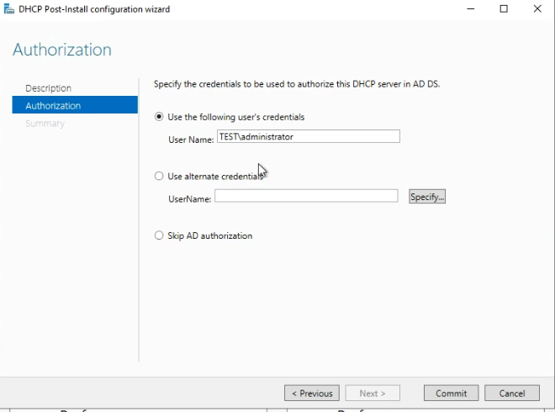
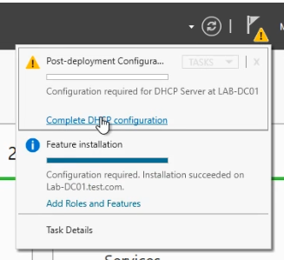
Authorize DHCP Server
Notes:
To authorize the server just click on the Notifications button and open the one about completing the DHCP server configuration. Make sure you use a user that has rights to do this task and click on Commit.

Slide 5
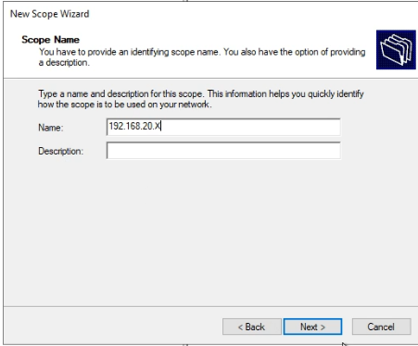
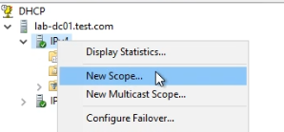
Create a new scope
Notes:
In the DHCP MMC console just right click on the server and select New scope.
Enter a scope name and a description is also good in case you have a lot of scopes on one server and want to easily know which is for what.

Slide 6
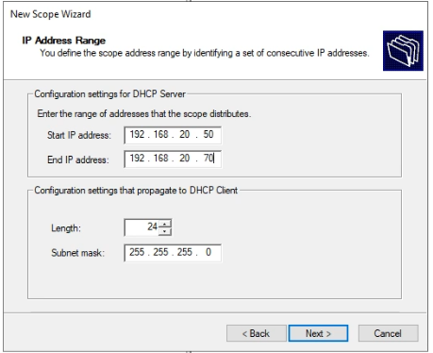
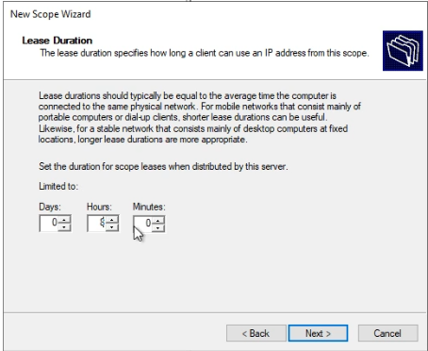
Create a new scope
Notes:
Enter the start and end IP address for the DHCP range. Make sure that the subnet mask is correct with regards to your network settings for this scope.
Each lease has an expiration time. By default, DHCP puts this time to 8 days but I usually set it to 8 hours.

Slide 7
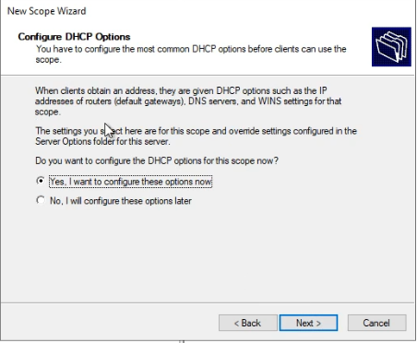
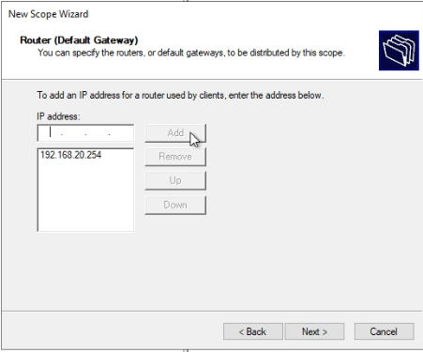
Create a new scope
Notes:
Each scope has a couple of settings or options that it can inherit from the server level or have configured especially for it. Since this is a new server and we have not set any server level options, let’s also configure them.
The default gateway is your router IP address that will permit the server to connect with other networks.

Slide 8
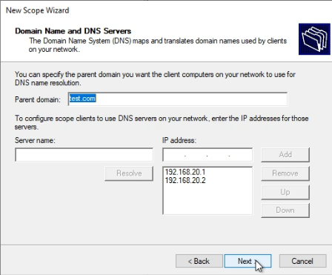
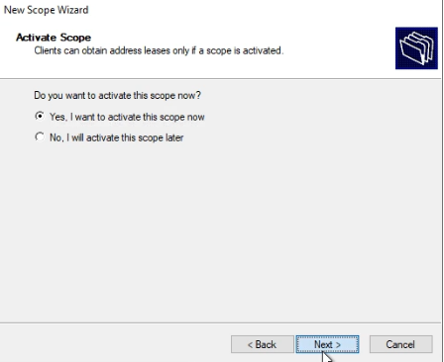
Create a new scope
Notes:
Make sure that the DNS settings are correct. In this example the 2 DNS servers from the domain are configured.
You can activate the scope immediately or keep it disabled until your are ready with your configuration.

Slide 9
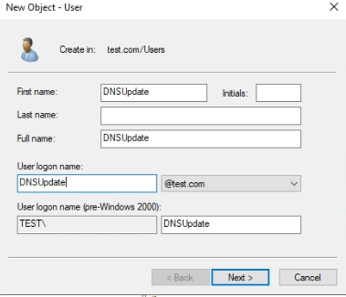
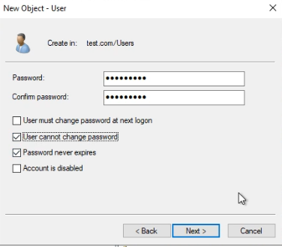
Create user for DNS dynamic updates
Notes:
In order to change the user that will perform dynamic DNS updates every time a change in DHCP leases happens, we need to create a user in Active Directory. This user will make all updates to DNS.
Give it a strong password and make sure you select Password never expires.

Slide 10
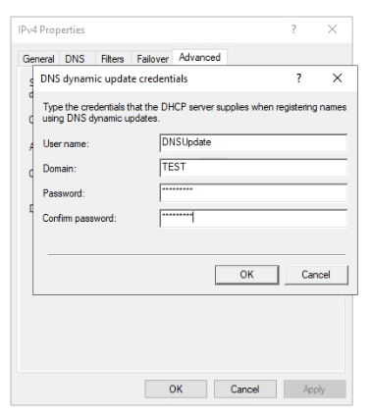
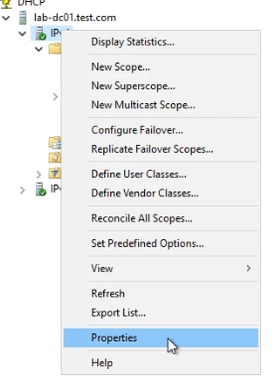
Create user for DNS dynamic updates
Notes:
To set the user in the DHCP settings just go to IPv4, right click and select Properties.
Go to Advanced and click on Credentials. Just enter the user name, domain and password.
After you set this up just restart the DHCP service.

Slide 11
https://www.youtube.com/channel/UCcZ-jLbPwNr8E_v9-65n8Iw https://github.com/itknowledge4

